Slide 1

IPL Winner Prediction
Group 15 Section 2
Team members:
Quazi Ahanaf Alif – 14101166
Mahfuzur Rahman – 14301135
Ajmain Inqiad Alam – 14301054
Abdullah Umar Nasib - 17341001

Slide 2
Explanation About Topic
Area of work: Supervised Learning
Specifically: Predictions
Area Covered:
Data mining
Data analytics
Pattern analysis

Slide 3
The Dataset
1. Explanation about each column
2. Input features
3. Output features
4. Relationships among the columns
5. Outliers
6. No Null value

Slide 4
The Used Algorithms
1. Fitted algorithms: KNN, Random Forest, Decision tree, Logistic regression, etc
2. Used: Logistic regression – discrete values probability
3. Properties: penalty, dual, tol, C, solver etc.
4. Using the algorithm by importing it from “sklearn.linear_model”

Slide 5
Explanation about the code
1. Enough resources
2. Code idea: GitHub
3. Enough Internet background check

Slide 6
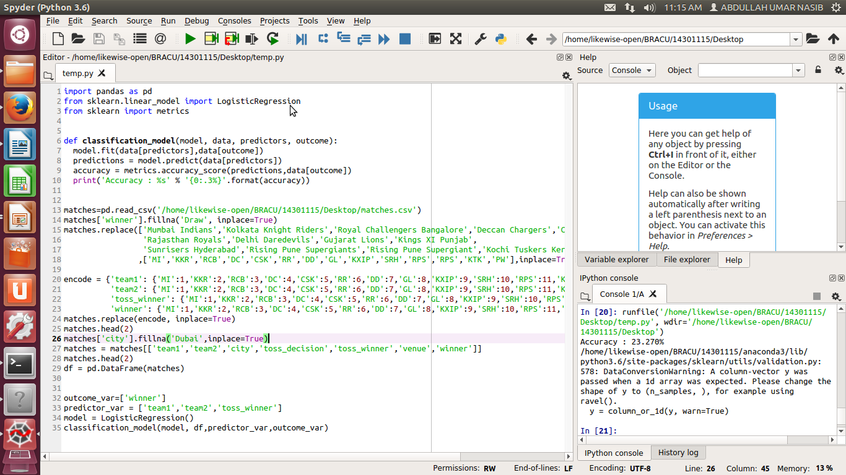
The code

Slide 7
The Program
Football Match Prediction
Two datasets:
Matches.csv
Deliveries.csv
Lab Content:
Libraries: pandas, sklearn
Methods: read_csv, replace, DataFrame
Winner of the match based on toss
Accuracy: 23.270%

Slide 8
Conclusion
1. Targeting to publish paper
2. Expected outcome from this project

Slide 9
Reference
1. www.kaggle.com
2. https://www.kaggle.com/gaurav896/ipl-analysis/data
3. https://www.kaggle.com/dhaval8895/ipl-analysis/notebook
4. Class Lecture

